Slide 1



PROVCO PINEGOOD PHOENIXVILLE, LLC
Presents
Route 23 and Whitehorse Road
Proposed Wawa Development

Slide 2
SCHUYLKILL TOWNSHIP
IN RE: APPLICATION OF PROVCO PINEGOOD PHOENIXVILLE, LLC
BOARD OF SUPERVISORS EXHIBITS
A-1 Aerial Plan
A-2 Existing Conditions Plan
A-3 Photographs of Existing Site Conditions (exterior and interior of existing Exxon Building)
A-4 Site Plan Rendering
A-5 Existing Conditions Overlay Plan
A-6 Proposed Fence Details
A-7 Zoning Table
A-8 Sign Details
A-9 Vehicle Circulation Plan

Slide 3
A-1 Aerial Plan

Slide 4
A-2 Existing Conditions Plan

Slide 5
A-3 Photos of Existing / Proposed Conditions

Slide 6
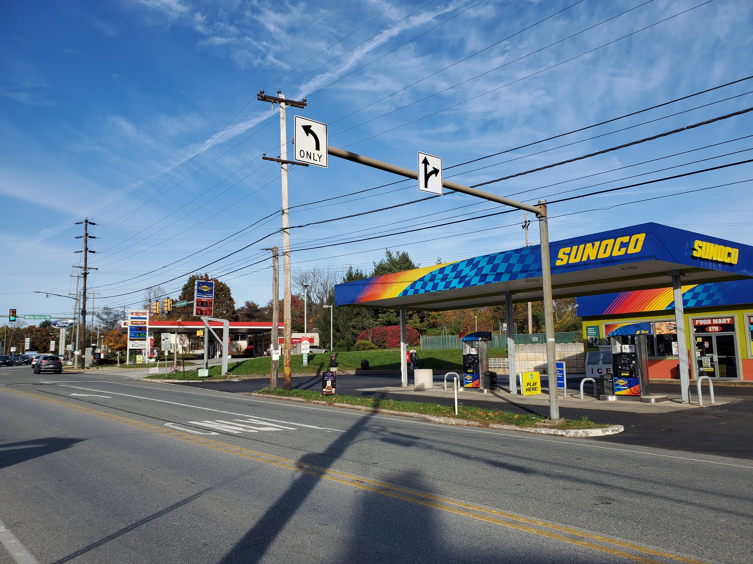
WB Canopy View Rt. 23

Slide 7
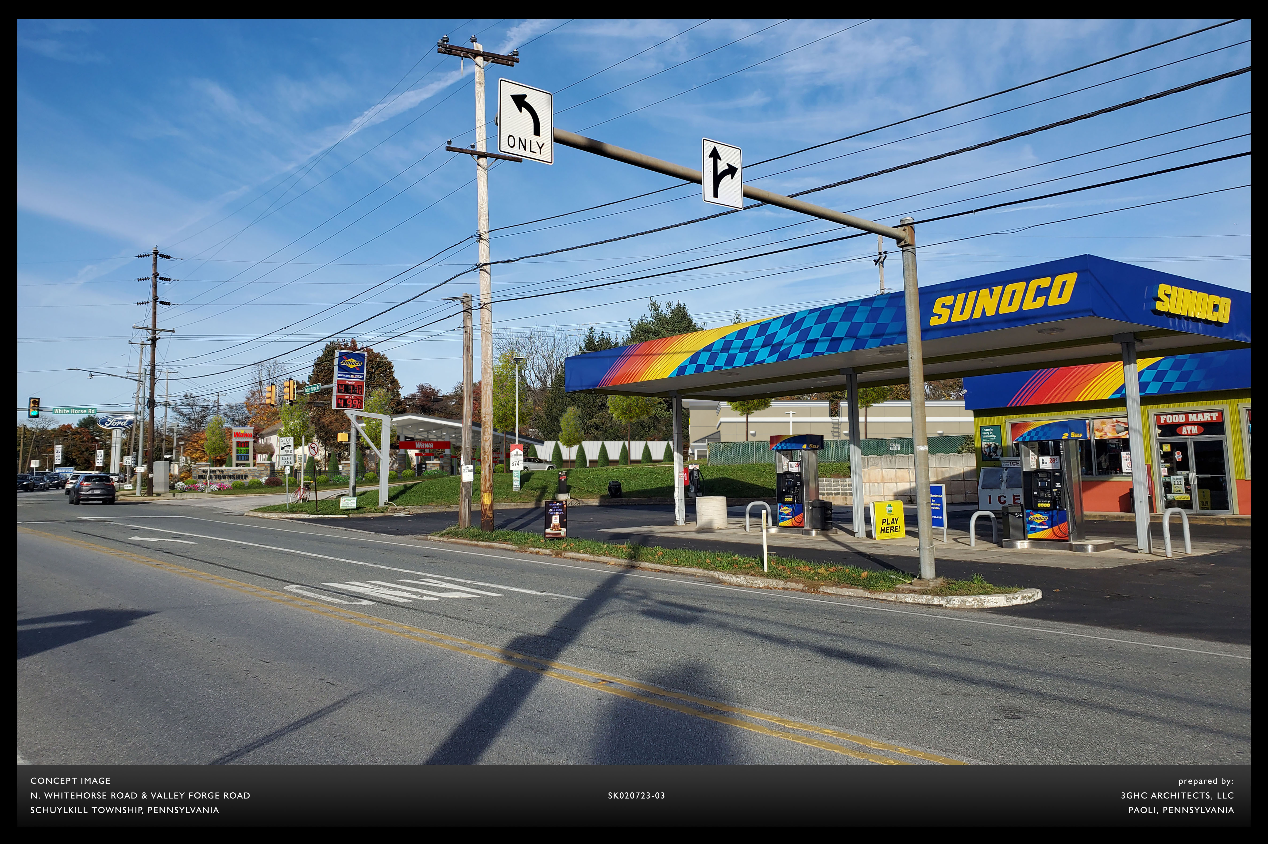
WB Wawa Canopy View Rt. 23

Slide 8
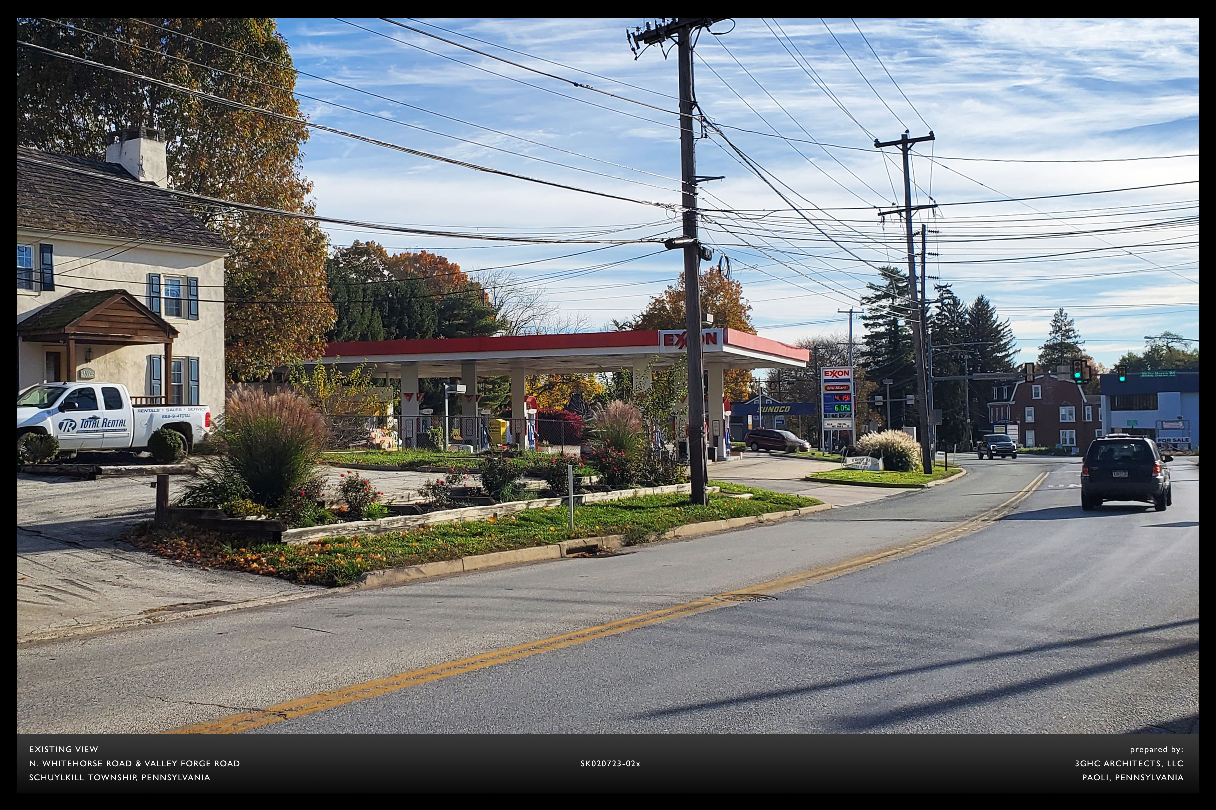
EB Exxon Canopy View Rt. 23

Slide 9
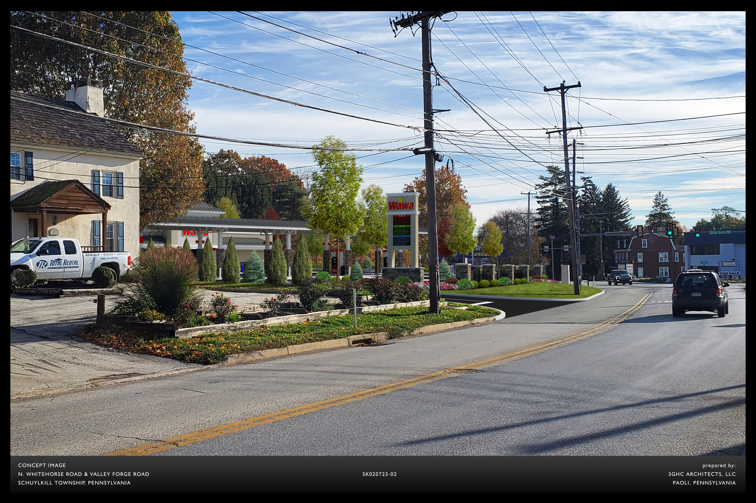
EB Wawa Canopy View Rt. 23

Slide 10
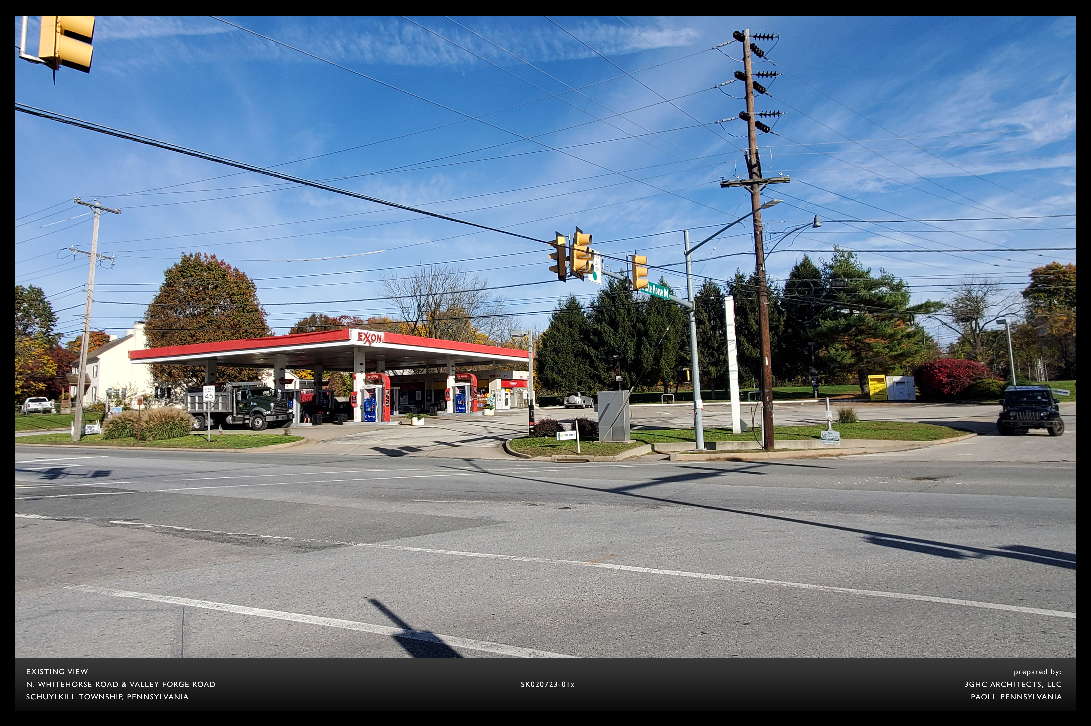

Slide 11
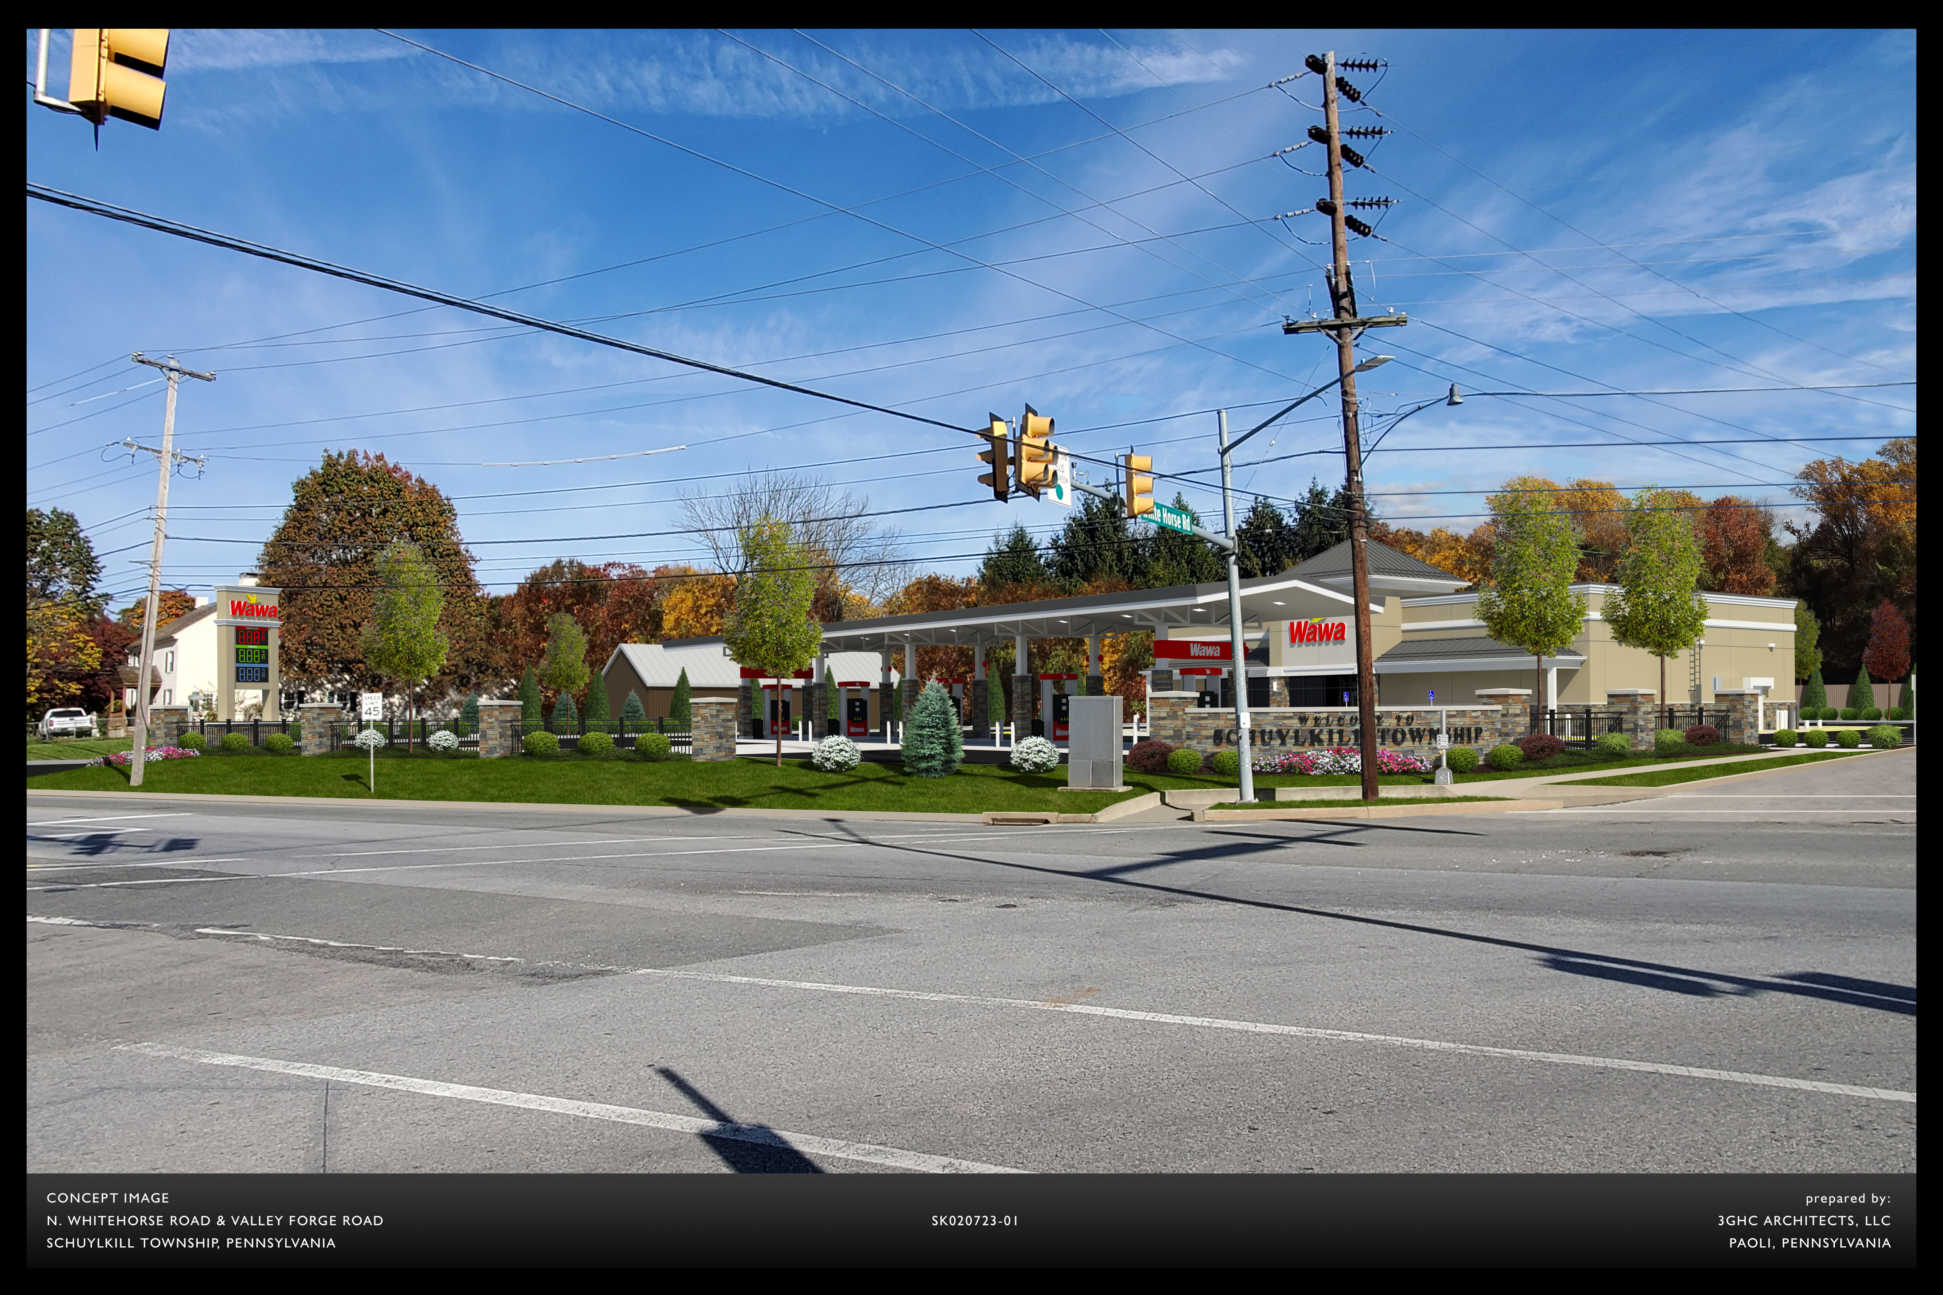

Slide 12
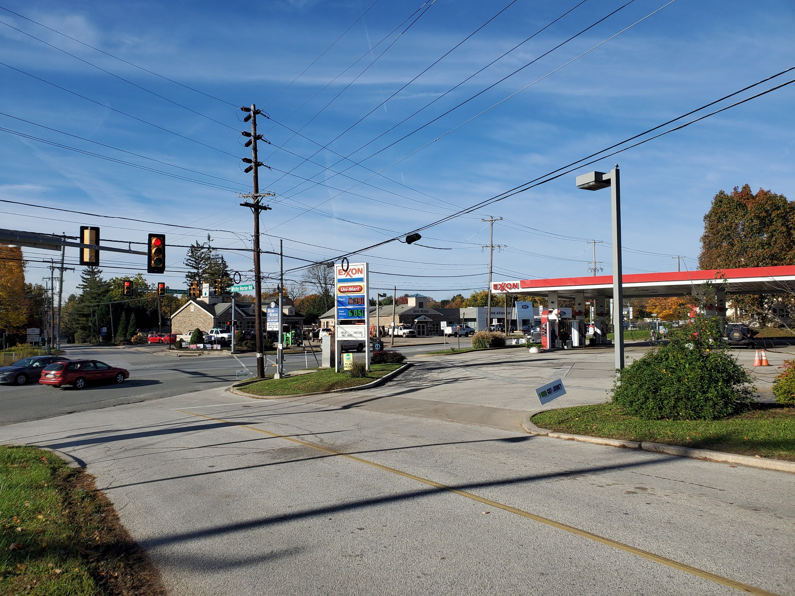
Whitehorse Rd. Entrance

Slide 13
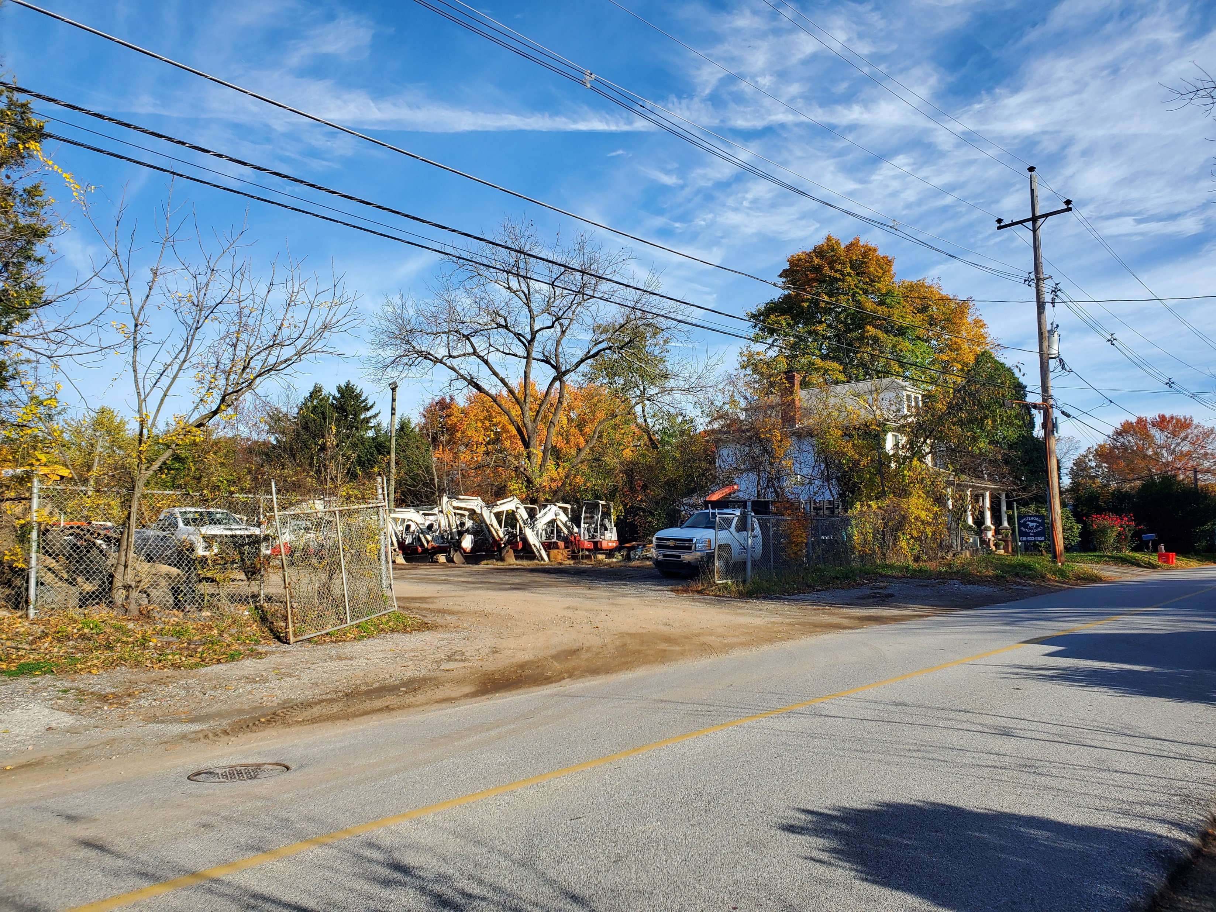
Total Rental Parking

Slide 14
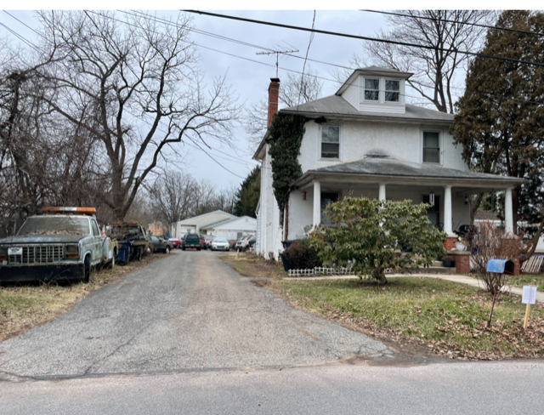
Whitehorse Auto

Slide 15
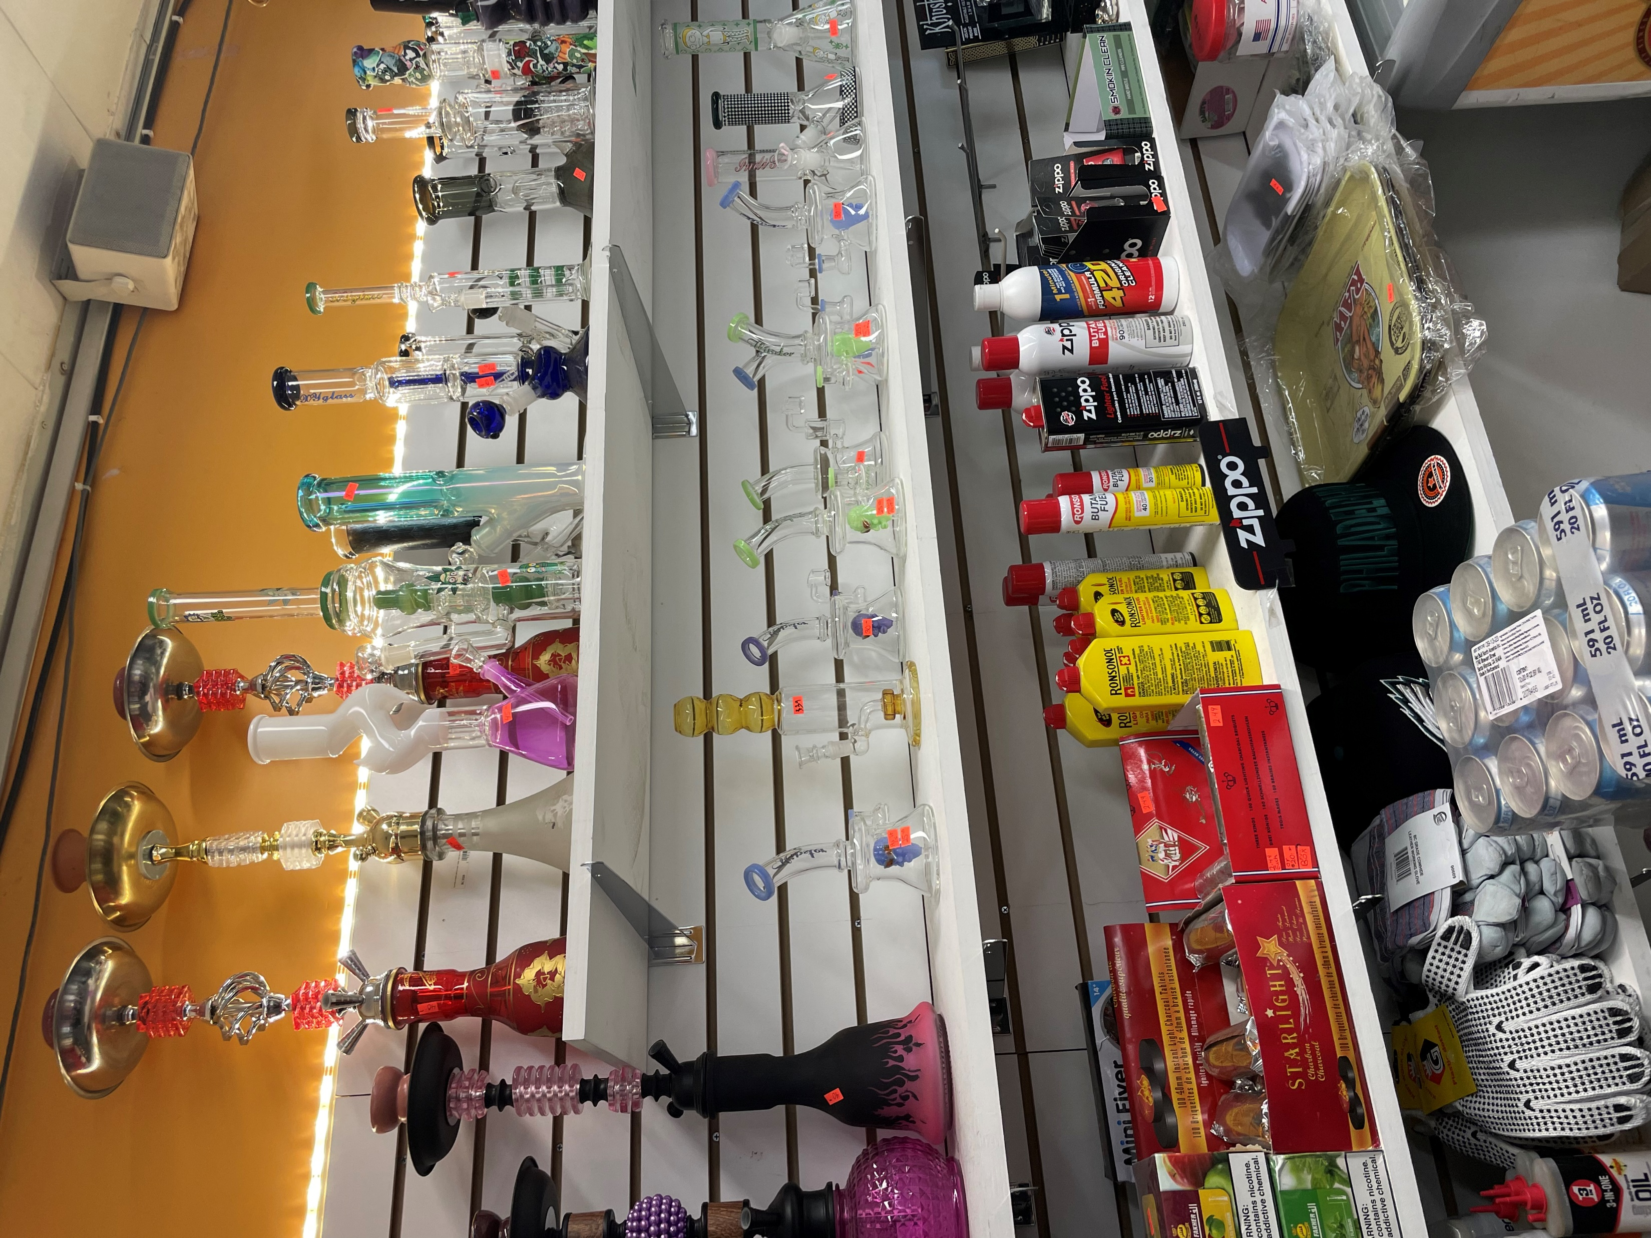
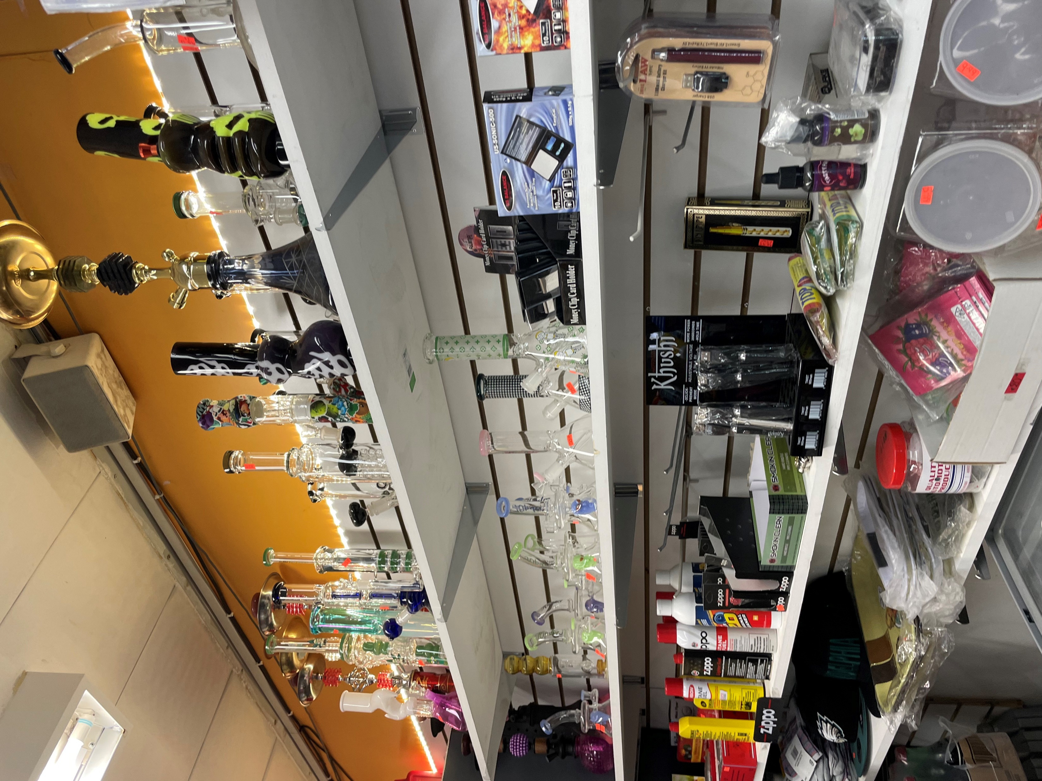
Exxon / Headshop?

Slide 16
A-4 Site Plan Rendering

Slide 17
A-5 Existing Conditions Overlay

Slide 18
A-6 Proposed Fence Details

Slide 19
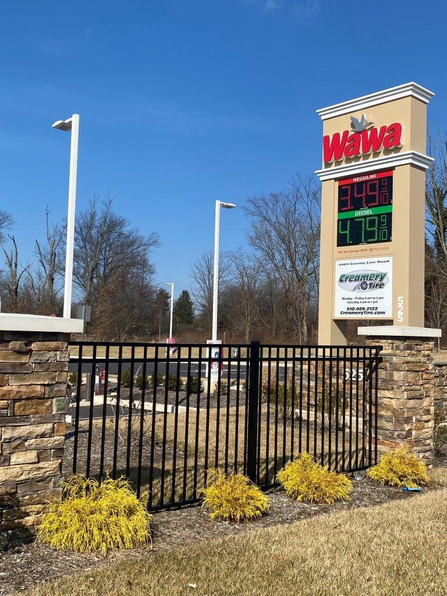
A-6 Proposed Pier Details

Slide 20
A-7 Zoning Table

Slide 21
A-8 Sign Details

Slide 22
A-9 Vehicle Circulation Plan

